Slide 1

AMAZON SALES ANALYSIS REPORT
SHANMUGASUNDARAM VIGNESH

Slide 2
INTRODUCTION
Objective: To analyse and visualize Amazon sales data using Power BI to get business insights and support decision-making.
Project Requirements:
Clean and prepare raw sales data from Amazon reports using Python.
Build an interactive dashboard in Power BI to visualize key sales metrics.
Derive business insights from trends in the data

Slide 3
Data and Approach
Data source: Amazon Sale Report
Preprocessing done in Jupyter Notebook
Cleaned missing values
Removed irrelevant columns
Added Month, Year, Weekday and Revenue Bracket
Visualization Tool: Power Bi

Slide 4
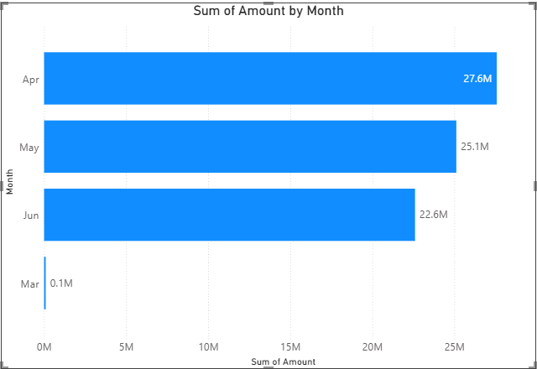
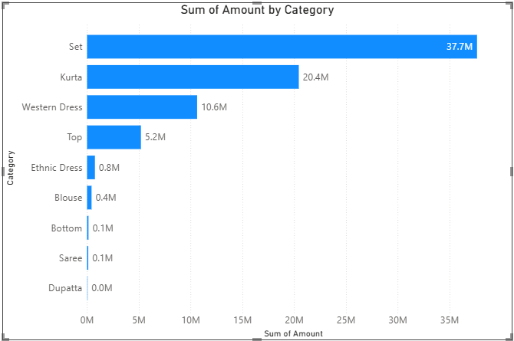
Key Insights
Monthly sales trend: Sales peaked in April
Category Analysis: Sets and kurtas dominate sales

Slide 5
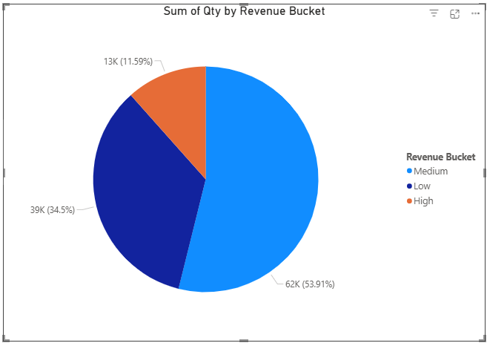
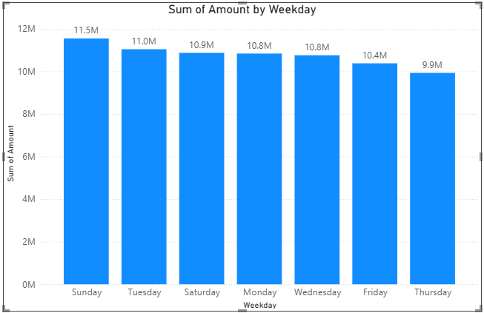
Key Insights
Revenue bucket distribution: Majority of orders fall in Medium
Weekday Analysis: Sales peak during Sunday

Slide 6
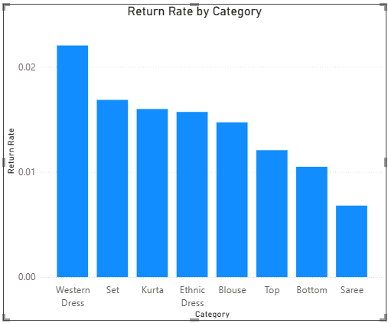
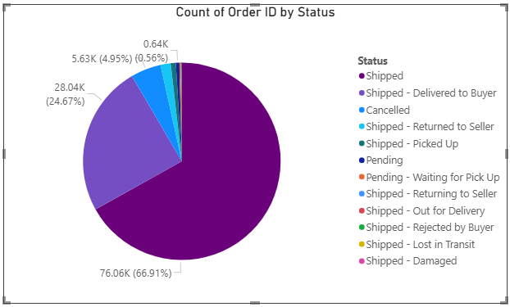
Key Insights
Return rate trend: Western Dress had highest return rate
Status Analysis: Over 66 percent are shipped

Slide 7
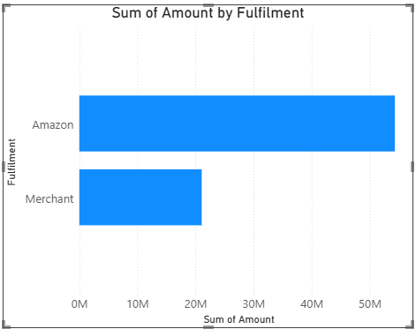
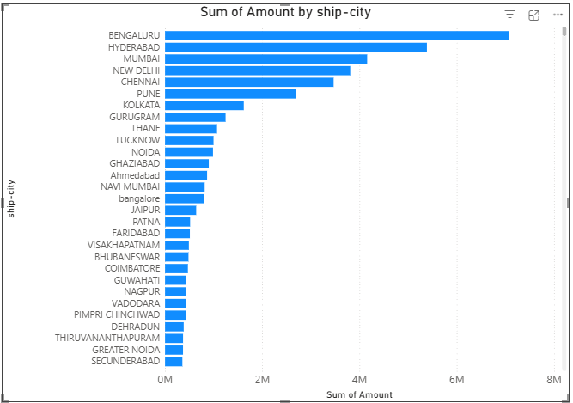
Key Insights
Fulfilment distribution: Products shipped by Amazon are outselling merchant-fulfilled ones
Sales by city: Bengaluru contributes highest revenue share

Slide 8
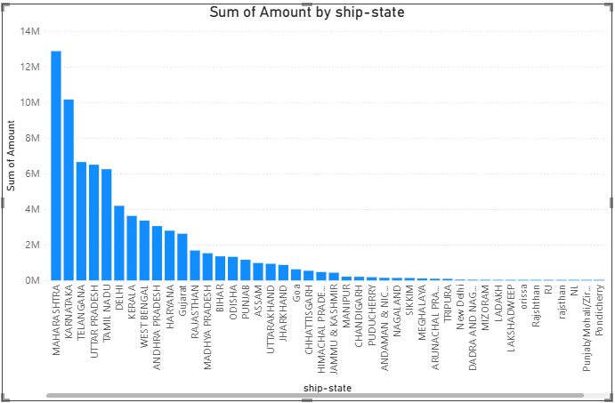
Key Insights
Sales by state: Maharashtra contributes highest revenue share among all states

Slide 9
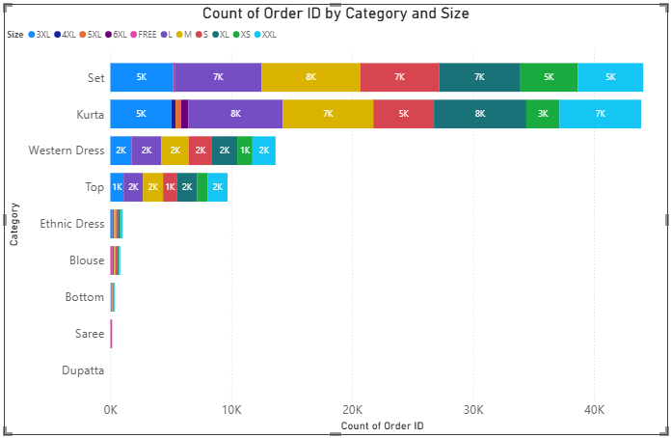
Key Insights
Orders by Category and Size: Set and Kurta dominate with Medium and Large sizes respectively

Slide 10
Recommendations
Seasonal Trends: Boost marketing and inventory ahead of April, the peak month, with targeted campaigns and discounts.
Promote Best-Selling Categories: Run ads and combo offers on Sets and Kurtas
Upsell in Medium Revenue Range: Since most orders fall in the medium revenue bucket, offer upgrades to shift more users toward high-value purchases.
Weekend Promotions: Launch flash sales or exclusive deals on Sundays
Reduce Returns in Western Dresses: Analyse return reasons and improve quality checks for Western Dresses.
Maintain Strong Shipping Performance: With a 66% shipment success rate, continue optimizing logistics.
Prioritize Amazon Fulfilment: Encourage sellers to use Amazon's fulfilment services for higher customer satisfaction.
Focus on High Revenue Cities and States: Target high revenue generating locations like Maharashtra with location-specific ads and replicate its strategy in underperforming locations
Sales are heavily concentrated in the Set and Kurta categories, with 'Medium' and 'Large' being the most preferred sizes.

Slide 11
THANK YOU

